Slide 1

Career Progression through personal branding
My story
Paul Suchmann Apenu | Ghana Chapter
  18 09 2024

Slide 2
Outline
Context
The VIP of Personal Branding
Vision statement
Improvement mindset
Promotion of personal brand
Conclusion

Slide 3
Context
Chris Ducker posited that “your brand is what people say about you when you are not in the room”
Based on a study conducted in USA, 85% of hiring professionals indicated that employees’ positive online reputation influenced hiring decisions
An executive survey in USA, estimates that 44% of their companies' market value is attributable to the reputation of their CEOs
From the above, we can establish the nexus of personal branding and how it promotes career advancement and business growth

Slide 4
Context
If your brand is how people perceive you and what they say when you are not in the room, how can you leverage on your personal branding to promote a positive image for career advancement.
In the previous presentation by PKA, he shared experiences on business start-up and growth. Today, we would share experiences as an employee than an employer.
We shall discuss how we position ourselves for advancement/promotion at the workplace through the VIP of personal branding. We shall explore how theory meets practice or vice versa
It is my prayer that you would be intentional about being “VIP” for career success

Slide 5
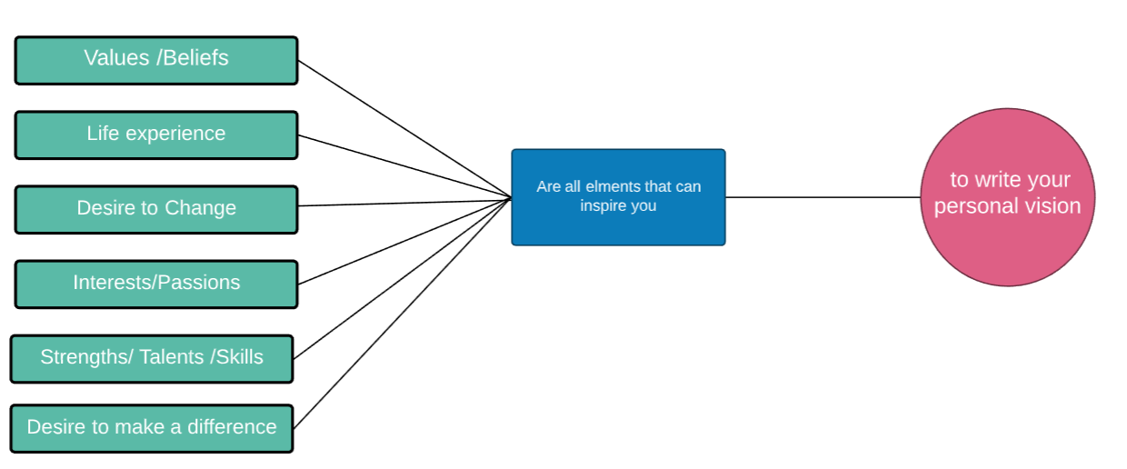
Vision Statement – crafting a personal vision statement
Source: Sabine Fable, PMP/ACP®

Slide 6
Vision Statement – framework for personal leadership branding
Leadership performance
Leading people
Leading self

Slide 7
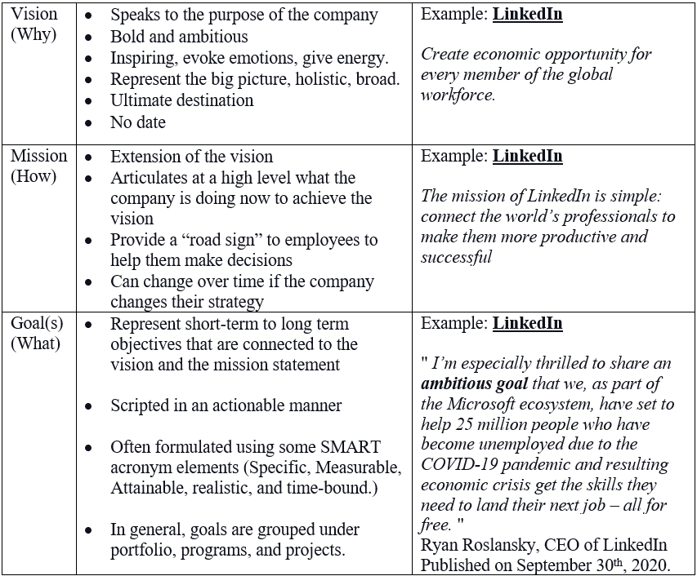
Vision Statement - Example
Source: Sabine Fable, PMP/ACP®

Slide 8
Improvement Mindset – the “TEE”
Executive Presence
Emotional Intelligence
Thought Leadership

Slide 9
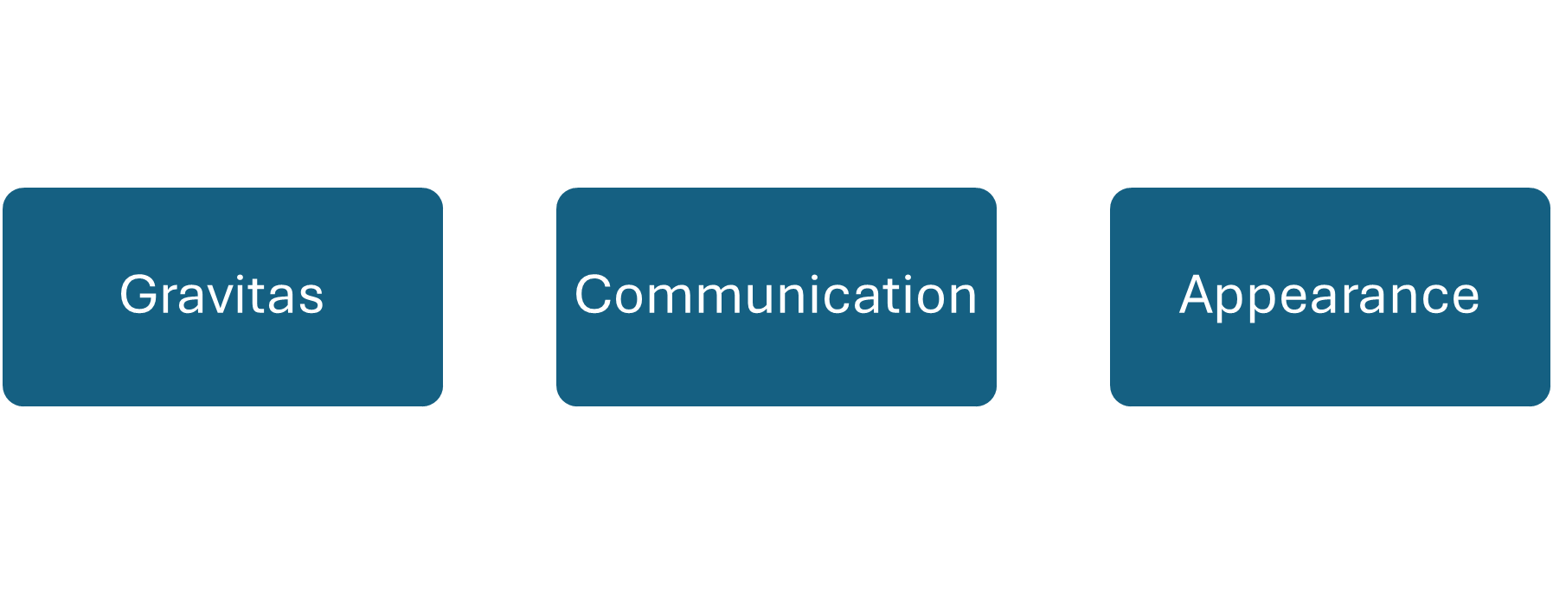
Improvement Mindset - Executive Presence

Slide 10
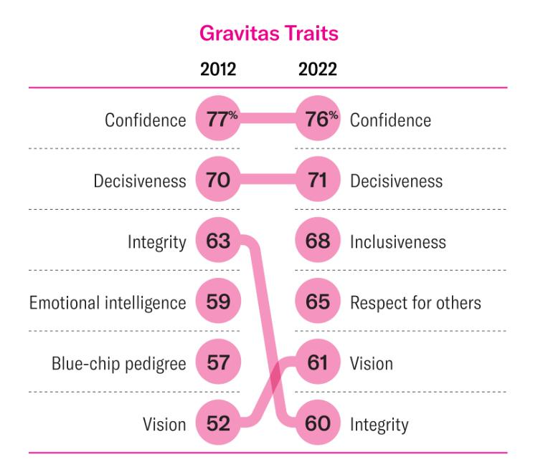
Executive Presence - Gravitas

Slide 11
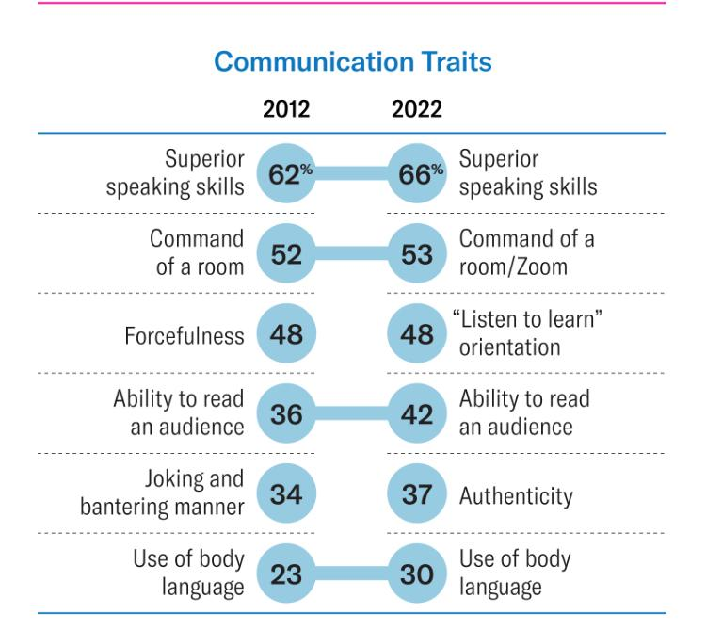
Executive Presence - Communication

Slide 12
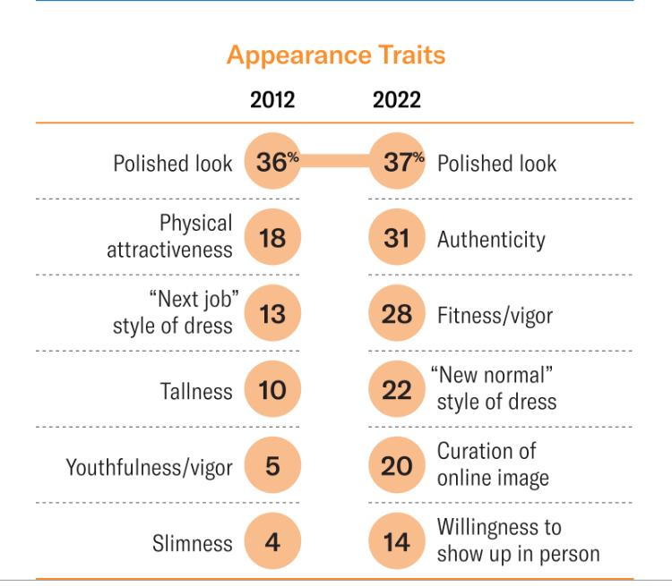
Executive Presence - Appearance

Slide 13
Improvement Mindset - Emotional Intelligence (EI)
"Emotional Intelligence includes the ability to engage in sophisticated information processing about one's own and others' emotions and the ability to use this information as a guide to thinking and behavior. That is, individuals high in emotional intelligence pay attention to, use, understand, and manage emotions, and these skills serve adaptive functions that potentially benefit themselves and others."

Slide 14
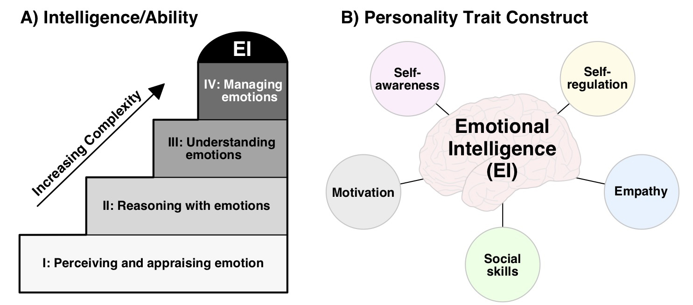
Improvement Mindset – understanding EI Models

Slide 15
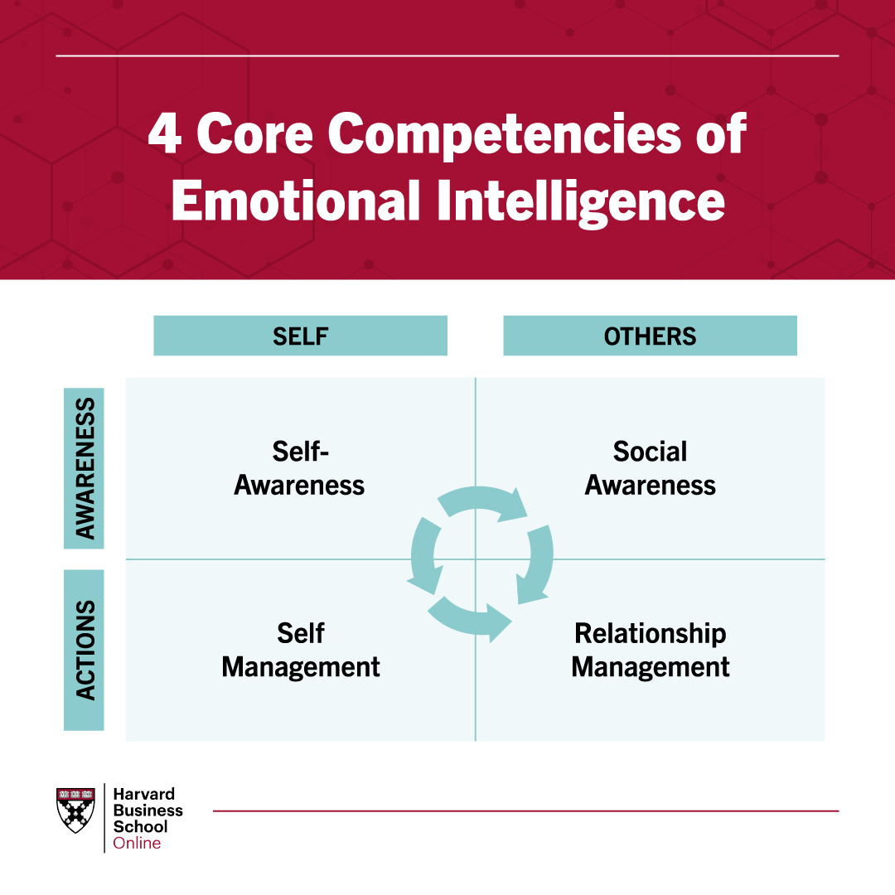
Improvement Mindset – understanding EI Models

Slide 16
Improvement Mindset – Developing Thought Leadership
Consistency
Originality
Value creation

Slide 17
Improvement Mindset – Thought Leadership: Consistency
Quality over quantity
Content scheduling
Thematic cohesion

Slide 18
Improvement Mindset – Thought Leadership: Originality
Research and trend analysis
Personal experience
Challenging norms

Slide 19
Improvement Mindset – Thought Leadership: Value creation
Taking care of audience’s needs/pain points
Education, information and provision of actionable insights
Feedback encouragement and adaptation

Slide 20
Publication/Promotion of Personal Brand
Identify your audience
Online presence – website, LinkedIn, professional networks

Slide 21
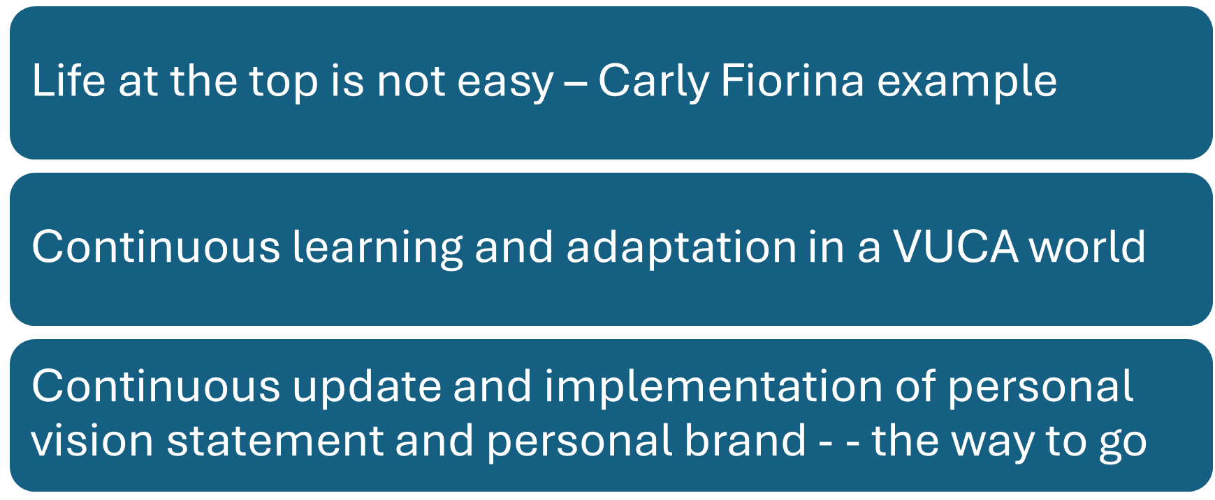
Conclusion
Not everyone can be top of their organization, but you can be top of your game. Successful people do the things unsuccessful people do

